Slide 1

Lecture 1
ORTHOGONAL APPROXIMATION
JOHN L. JUNKINS & ROBYN M. WOOLLANDS
Five Part Lecture Series
Picard-Chebyshev Numerical Integration
Applications in Astrodynamics
Texas A&M University
Department of Aerospace Engineering
College Station, TX 77840
Spring 2017

Slide 2

JUNKINS & WOOLLANDS
Picard-Chebyshev Lecture Series
#1 Orthogonal Approximation
FIVE PART LECTURE SERIES
Lecture | Title | Presenter
1 | Orthogonal Approximation | Junkins
2 | Numerical Quadrature | Junkins
3 | Picard Chebyshev Methods & Theoretical Convergence | Woollands
4 | Accelerated Picard Iteration & Adaptive Segmentation | Woollands
5 | Gravity Approximations | Junkins
2

Slide 3


JUNKINS & WOOLLANDS
Picard-Chebyshev Lecture Series
#1 Orthogonal Approximation
CONTACT INFORMATION
JOHN L. JUNKINS
Distinguished Professor of Aerospace Engineering
Texas A&M University
Department of Aerospace Engineering
College Station, TX 77840
junkins@tamu.edu
ROBYN M. WOOLLANDS
Postdoctoral Research Associate
Texas A&M University
Department of Aerospace Engineering
College Station, TX 77840
robyn.woollands@gmail.com
3

Slide 4
JUNKINS & WOOLLANDS
Picard-Chebyshev Lecture Series
#1 Orthogonal Approximation
MOTIVATION
During recent years significant progress has been made on iterative path approximation methods for solving nonlinear ordinary differential equations that arise in mechanics and control. Several of John Junkins’ recent PhD students have made significant contributions:
Xiaoli Bai, 2010 (Assist. Prof at Rutgers University)
Ahmad Bani Younes, 2013 (Assist Prof. at Khalifa University)
Donghoon Kim, 2013 (Postdoctoral Researcher at Oklahoma State University)
Tarek Elgohary, 2015 (Assist. Prof at University of Central Florida)
Brent Macomber, 2015 (GNC Engineer at SpaceX)
Robyn Woollands, 2016 (GNC Engineer at NASA’s Jet Propulsion Lab, May 2017-)
Julie Read, 2016 (GNC Engineer at NASA’s Johnson Space Center)
Austin Probe, PhD Candidate (GNC Engineer at Emergent Technologies, Inc.)
Our effort has led to multiple formulations and algorithms for specific circumstances/ applications. These lectures provide a tutorial explanation and not-too-detailed summary of some of these methods and algorithms as we make our Picard Adaptive Path Approximation (PAPA) Software Release 1.0.
The path approximation differential equation solvers to be presented rely on certain results from function approximation theory and approximation of the approximated functions’ integrals and derivatives using orthogonal polynomials. So the first two lectures address these basic issues. Examples are given throughout. While we focus mainly on one dimensional approximation, we include some extensions to n dimensions.
4

Slide 5
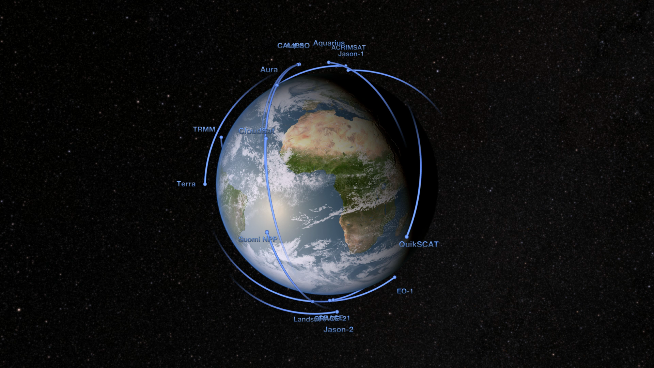
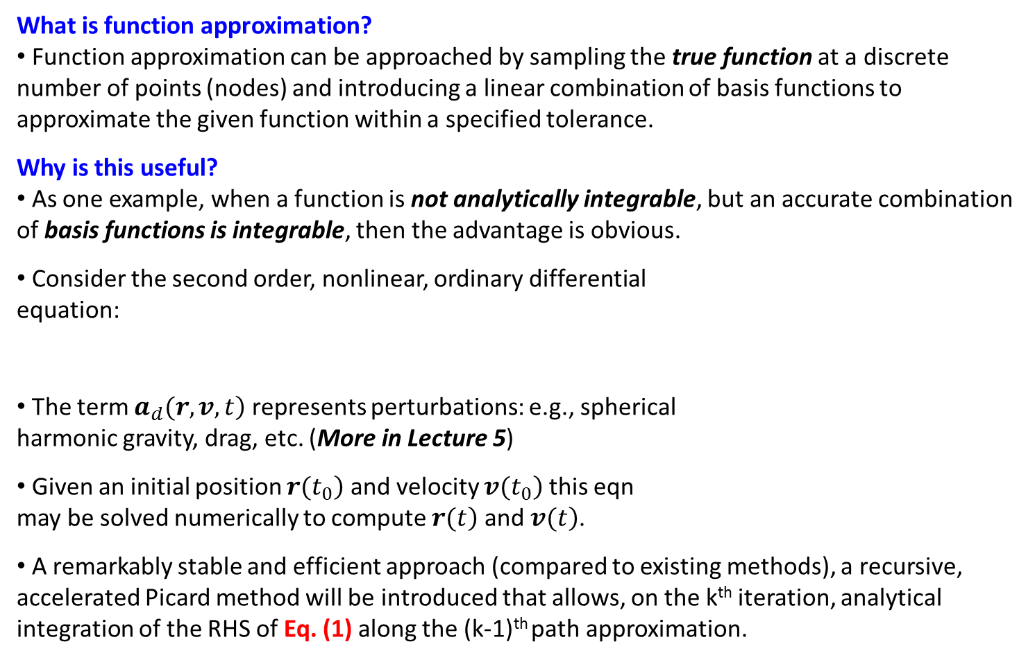
JUNKINS & WOOLLANDS
Picard-Chebyshev Lecture Series
#1 Orthogonal Approximation
FUNCTION APPROXIMATION
What is function approximation?
Function approximation can be approached by sampling the true function at a discrete number of points (nodes) and introducing a linear combination of basis functions to approximate the given function within a specified tolerance.
Why is this useful?
As one example, when a function is not analytically integrable, but an accurate combination of basis functions is integrable, then the advantage is obvious.
Consider the second order, nonlinear, ordinary differential
equation:
The term $\left.a_{d}(r,v,t\right)$ represents perturbations: e.g., spherical harmonic gravity, drag, etc. (More in Lecture 5)
Given an initial position $\left.r(t_{0}\right)$ and velocity $\left.v(t_{0}\right)$ this eqn
may be solved numerically to compute $\left.r(t\right)$ and$\left. v(t\right)$.
A remarkably stable and efficient approach (compared to existing methods), a recursive, accelerated Picard method will be introduced that allows, on the k^{th} iteration, analytical integration of the RHS of Eq. (1) along the (k-1)^{th} path approximation.
NASA/Goddard Space Flight Center
Scientific Visualization Studio
5

Slide 6
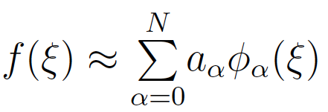
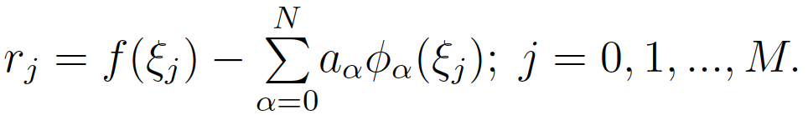
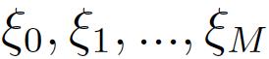
JUNKINS & WOOLLANDS
Picard-Chebyshev Lecture Series
#1 Orthogonal Approximation
APPROXIMATION AND RESIDUAL ERRORS
How to approximate a function?
Approximating a function is done in a way the minimizes SOME MEASURE of the error (or residual) between the true and approximate functions.
Approximation
The function, f(ξ), is approximated by a sum of N+1 polynomials basis functions {φ₀(ξ), φ₁(ξ), … , φ_{M}(ξ)} as shown:
Residuals
The residual errors are simply the difference between the function computed at each of the M+1 nodes and the approximated values (for specified N and basis function the residuals are a function only of the coefficients {a₀, a₁, … , a_{N}}):
Basis Function
(e.g., Chebyshev Polynomials)
Coefficients
(Chebyshev Coefficients)
Residual
Function Evaluated
at Sample Points
Discrete Sample Points (Nodes)
(e.g., Cosine Sampling or Uniform Sampling)
6

Slide 7
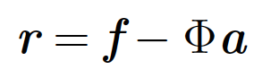
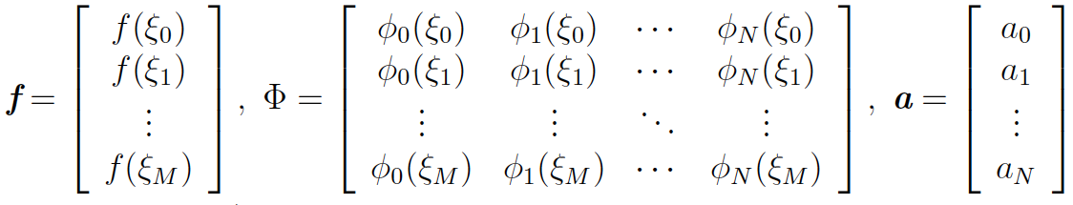
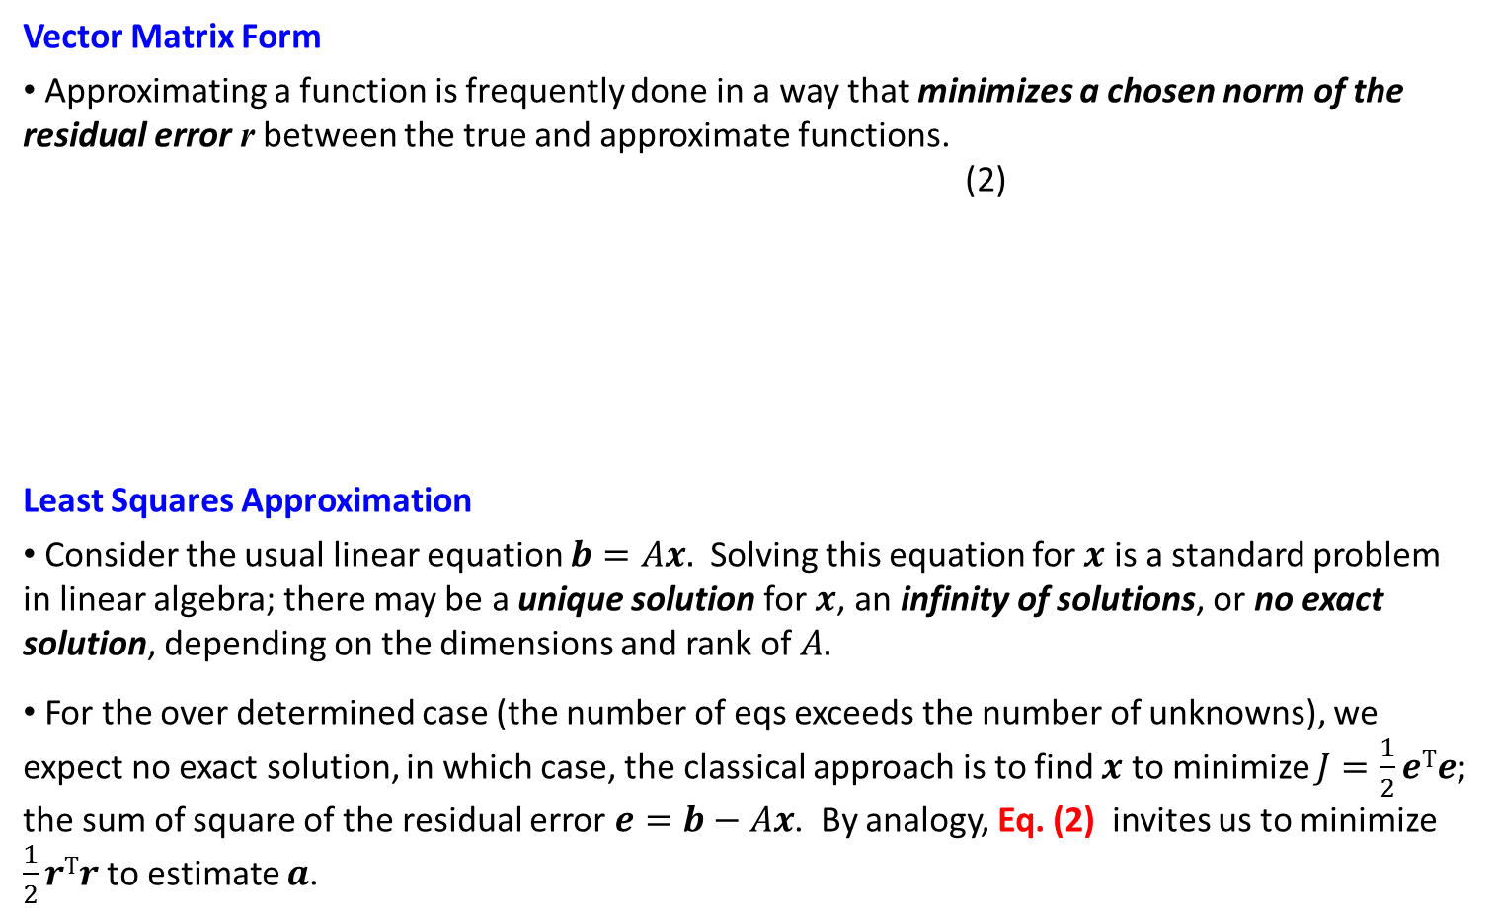
JUNKINS & WOOLLANDS
Picard-Chebyshev Lecture Series
#1 Orthogonal Approximation
VECTOR MATRIX & LEAST SQUARES
Vector Matrix Form
Approximating a function is frequently done in a way that minimizes a chosen norm of the residual error r between the true and approximate functions.
(2)
Least Squares Approximation
Consider the usual linear equation $b=Ax.$ Solving this equation for $x$ is a standard problem in linear algebra; there may be a unique solution for $x$, an infinity of solutions, or no exact solution, depending on the dimensions and rank of $A.$
For the over determined case (the number of eqs exceeds the number of unknowns), we expect no exact solution, in which case, the classical approach is to find $x$ to minimize $J=\frac{1}{2}eTe$; the sum of square of the residual error $e=b−Ax$. By analogy, Eq. (2) invites us to minimize $\frac{1}{2}rTr$to estimate $a$.
7
Notes:
*** AFTER LAST BULLET ***
More details on minimum norm can be found in Crassidis & Junkins 2011.

Slide 8
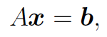
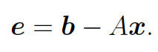
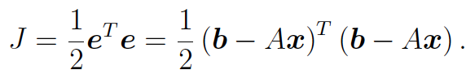
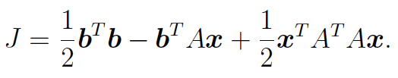
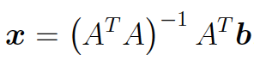
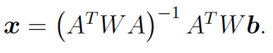
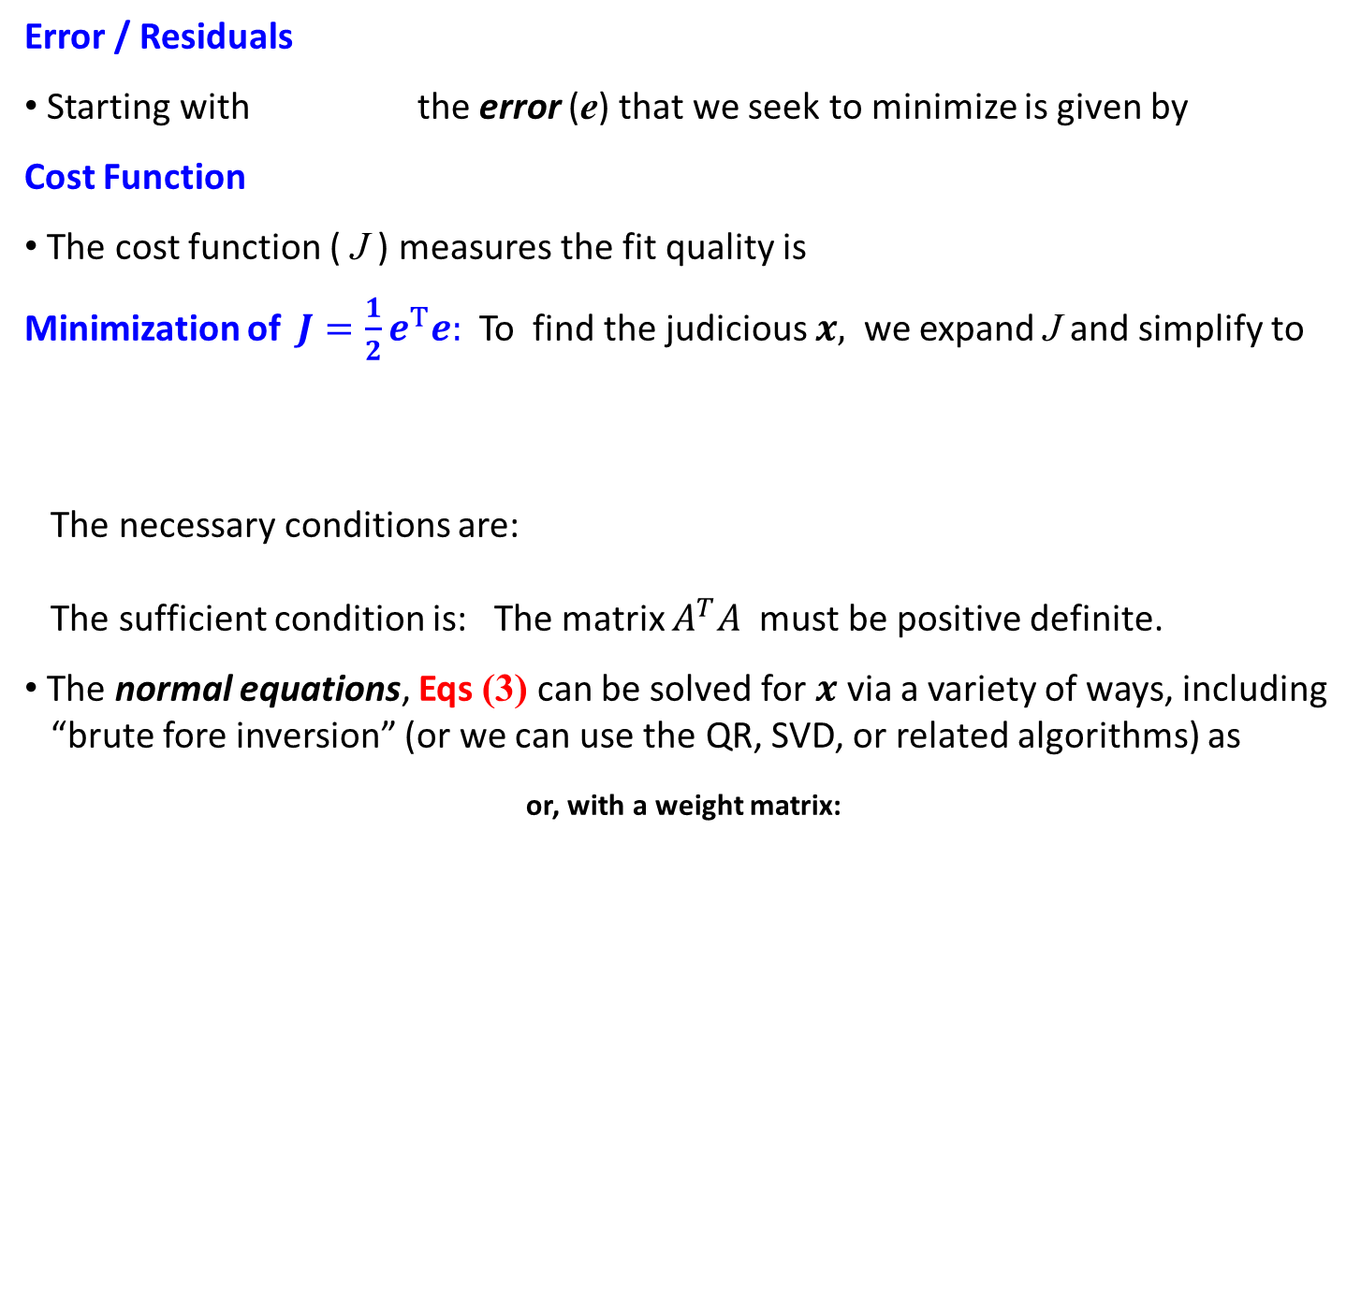
JUNKINS & WOOLLANDS
Picard-Chebyshev Lecture Series
#1 Orthogonal Approximation
LEAST SQUARES APPROXIMATION
Error / Residuals
Starting with the error (e) that we seek to minimize is given by
Cost Function
The cost function ( J ) measures the fit quality is
Minimization of$J=\frac{1}{2}e^{T}e:$To find the judicious $x,$ we expand J and simplify to
The necessary conditions are:
The sufficient condition is: The matrix $A^{T}A$ must be positive definite.
The normal equations, Eqs (3) can be solved for $x$ via a variety of ways, including “brute fore inversion” (or we can use the QR, SVD, or related algorithms) as
or, with a weight matrix:
8
Notes:
*** AFTER THE NORMAL EQUATIONS ***
The coefficients (x) of the approximating polynomial may be determined in terms of known quantities b and A. If desired, a positive definite weight matrix may also be included in the cost function, thus leading to the second equation set of normal equations containing the W weight matrix. For more details on Least squares please refer to Crassidis and Junkins 2011.

Slide 9
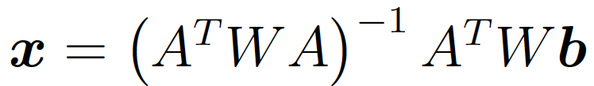
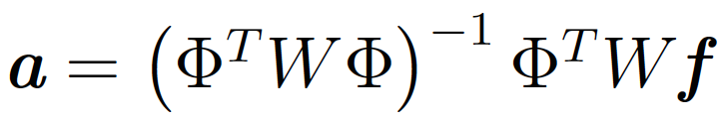
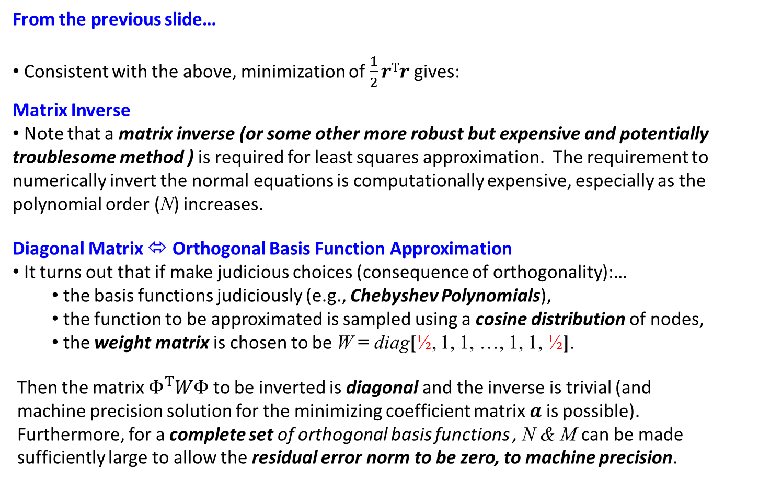
JUNKINS & WOOLLANDS
Picard-Chebyshev Lecture Series
#1 Orthogonal Approximation
MATRIX INVERSE
From the previous slide…
Consistent with the above, minimization of $\frac{1}{2}rTr$gives:
Matrix Inverse
Note that a matrix inverse (or some other more robust but expensive and potentially troublesome method ) is required for least squares approximation. The requirement to numerically invert the normal equations is computationally expensive, especially as the polynomial order (N) increases.
Diagonal Matrix ⬄ Orthogonal Basis Function Approximation
It turns out that if make judicious choices (consequence of orthogonality):…
the basis functions judiciously (e.g., Chebyshev Polynomials),
the function to be approximated is sampled using a cosine distribution of nodes,
the weight matrix is chosen to be W = diag[½, 1, 1, …, 1, 1, ½].
Then the matrix $Φ^{T}WΦ$ to be inverted is diagonal and the inverse is trivial (and machine precision solution for the minimizing coefficient matrix $a$ is possible). Furthermore, for a complete set of orthogonal basis functions , N & M can be made sufficiently large to allow the residual error norm to be zero, to machine precision.
9

Slide 10
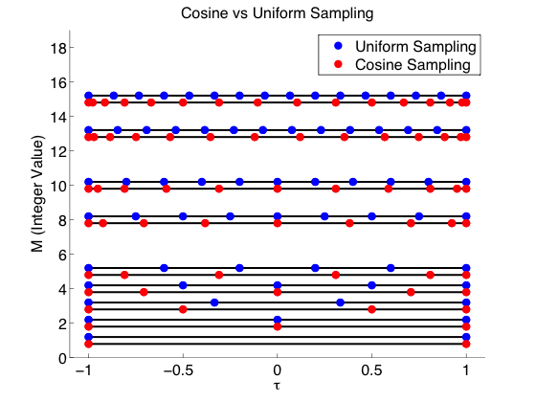
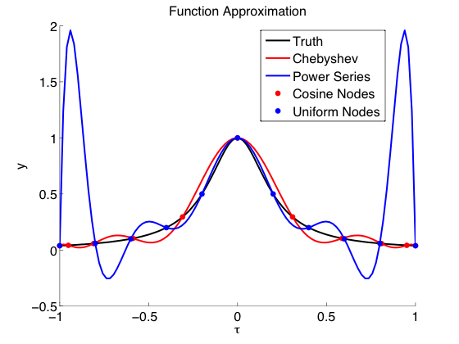
JUNKINS & WOOLLANDS
Picard-Chebyshev Lecture Series
#1 Orthogonal Approximation
COSINE SAMPLING
Sample Points
Sample points (of the forcing function to be fitted) are computed using a cosine node distribution as follows:
Runge Effect
Note clustering of cosine nodes near the ±1 boundaries. Uniform sampling leads to the “Runge effect” (large oscillatory errors between nodes near the boundaries due to lack of support outside the interval). Denser interior nodes helps compensate for absence of support to the right and left of the approximation interval. Qualitatively, cosine nodes lead to nearly uniform approximation errors.
run_lecture2.m
chebyshev.m
10

Slide 11
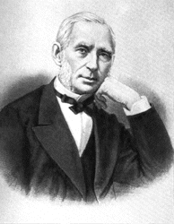
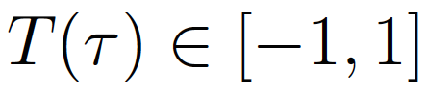
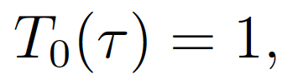
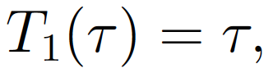
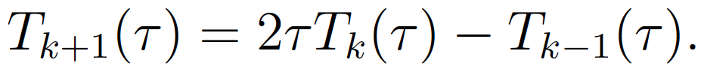
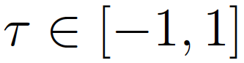
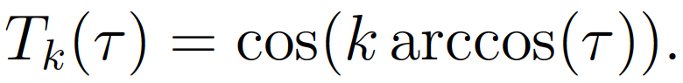
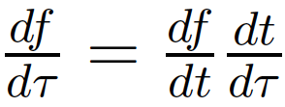
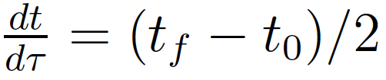
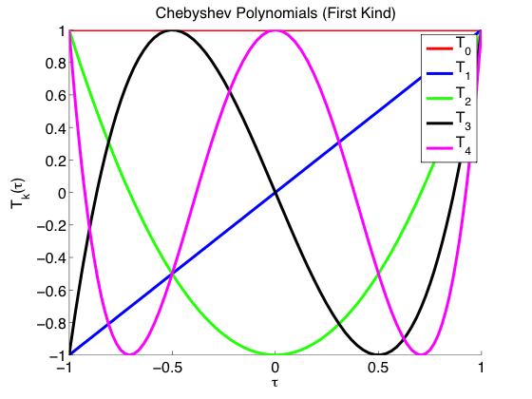
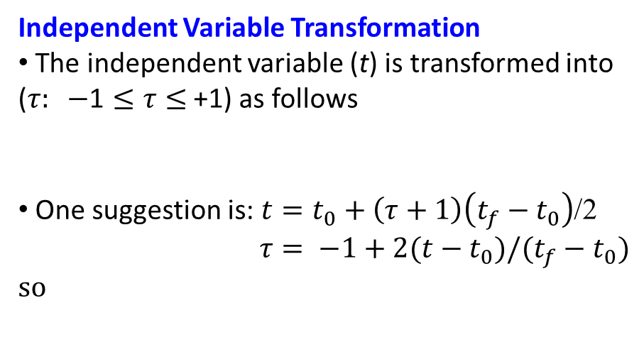
JUNKINS & WOOLLANDS
Picard-Chebyshev Lecture Series
#1 Orthogonal Approximation
CHEBYSHEV POLYNOMIALS
Definition
Chebyshev polynomials are defined on the range
Two ways to generate Chebyshev polynomials
1. Recursively
2. Trigonometrically
Picture Credit: Wikipedia
Rafnuty Chebyshev
(1821-1894)
Independent Variable Transformation
The independent variable (t) is transformed into ($τ: −\text{1}≤τ≤$ +1) as follows
One suggestion is: $t=t_{0}+\left(τ+1\right)\left(t_{f}−t_{0}\right)$/2
$τ= −1+2(t−t_{0})/(t_{f}−t_{0})$
so
run_lecture2.m
chebyshev.m
11

Slide 12
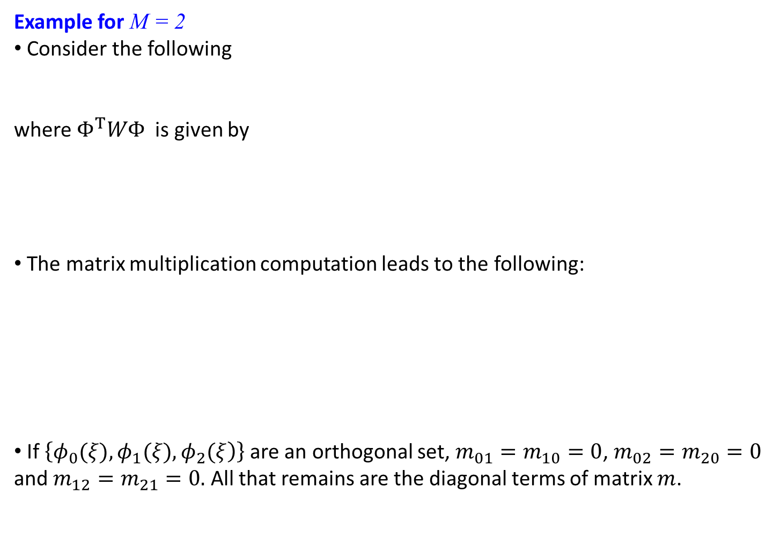
JUNKINS & WOOLLANDS
Picard-Chebyshev Lecture Series
#1 Orthogonal Approximation
WEIGHT MATRIX EXAMPLE
Example for M = 2
Consider the following
where $Φ^{T}WΦ$ is given by
The matrix multiplication computation leads to the following:
If $\left\{\left.φ_{0}(ξ),φ_{1}(ξ),φ_{2}(ξ\right)\right\}$are an orthogonal set, $m_{01}=m_{10}=0$, $m_{02}=m_{20}=0$ and $m_{12}=m_{21}=0.$ All that remains are the diagonal terms of matrix $m$.
12

Slide 13
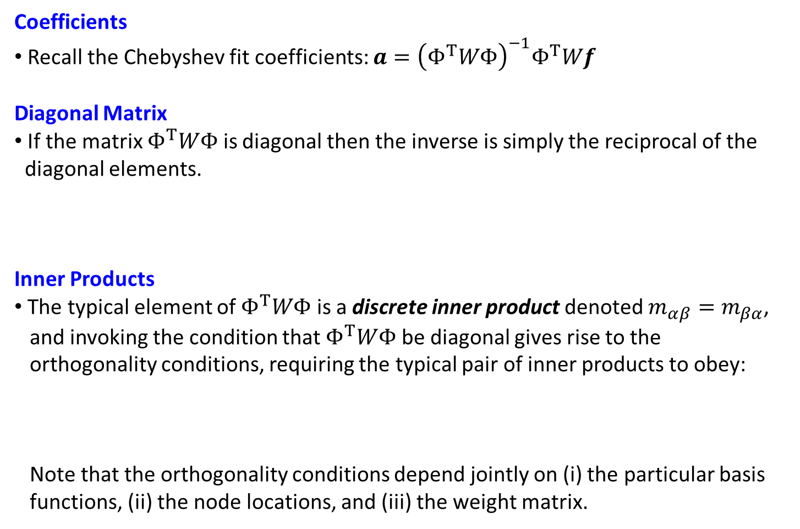
JUNKINS & WOOLLANDS
Picard-Chebyshev Lecture Series
#1 Orthogonal Approximation
WEIGHT MATRIX
Coefficients
Recall the Chebyshev fit coefficients: $a={\left(Φ^{T}WΦ\right)}^{−1}Φ^{T}Wf$
Diagonal Matrix
If the matrix $Φ^{T}WΦ$ is diagonal then the inverse is simply the reciprocal of the diagonal elements.
Inner Products
The typical element of $Φ^{T}WΦ$ is a discrete inner product denoted $m_{αβ}=m_{βα}$, and invoking the condition that $Φ^{T}WΦ$ be diagonal gives rise to the orthogonality conditions, requiring the typical pair of inner products to obey:
Note that the orthogonality conditions depend jointly on (i) the particular basis functions, (ii) the node locations, and (iii) the weight matrix.
13

Slide 14
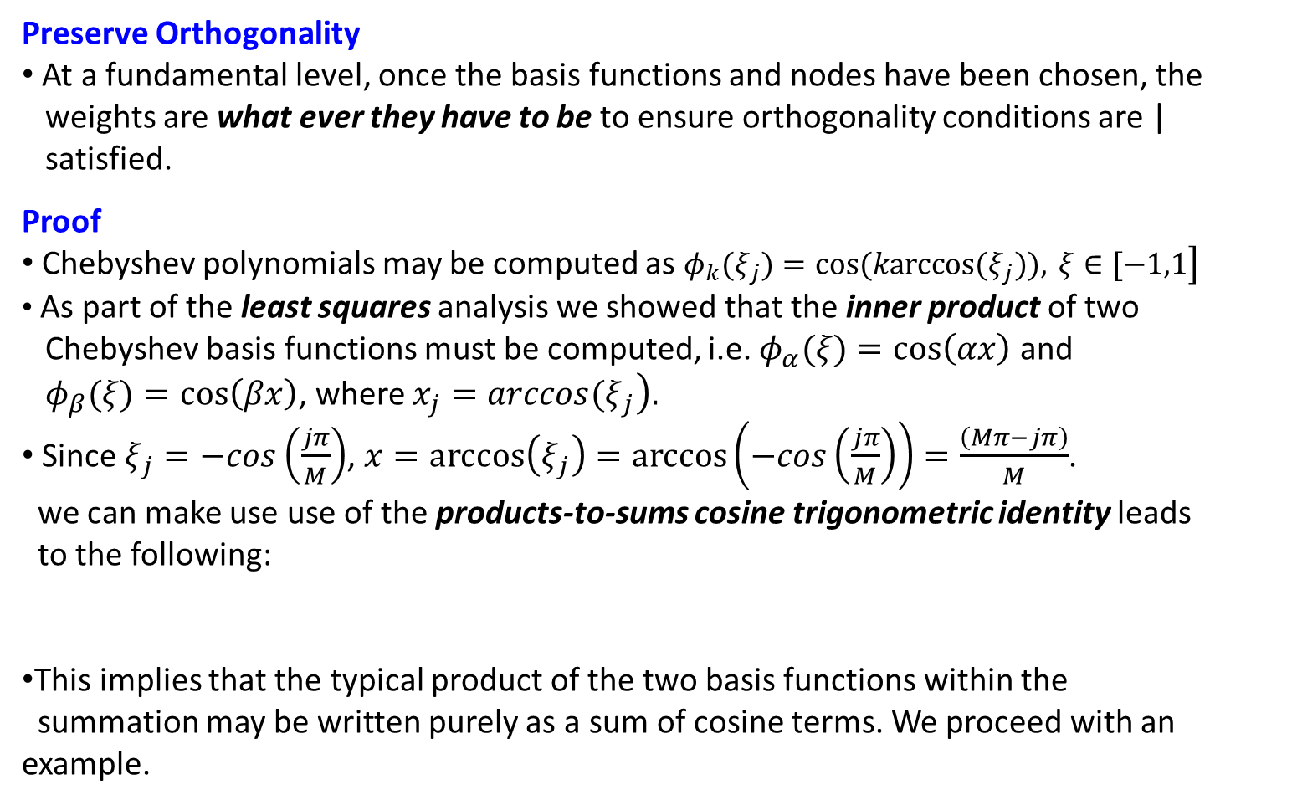
JUNKINS & WOOLLANDS
Picard-Chebyshev Lecture Series
#1 Orthogonal Approximation
WHY HALF?
Preserve Orthogonality
At a fundamental level, once the basis functions and nodes have been chosen, the weights are what ever they have to be to ensure orthogonality conditions are | satisfied.
Proof
Chebyshev polynomials may be computed as $\left.φ_{k}(ξ_{j})=cos(karccos(ξ_{j})), ξ∈[−1,1\right]$
As part of the least squares analysis we showed that the inner product of two Chebyshev basis functions must be computed, i.e. $φ_{α}(ξ)=cos\left(αx\right)$ and
${ φ}_{β}(ξ)=cos\left(βx\right)$, where $\left.x_{j}=arccos(ξ_{j}\right).$
Since $ξ_{j}=−cos\left(\frac{jπ}{M}\right)$, $x=arccos\left(ξ_{j}\right)=arccos\left(−cos\left(\frac{jπ}{M}\right)\right)=\frac{\left(Mπ−jπ\right)}{M}$.
we can make use use of the products-to-sums cosine trigonometric identity leads to the following:
This implies that the typical product of the two basis functions within the summation may be written purely as a sum of cosine terms. We proceed with an example.
14

Slide 15
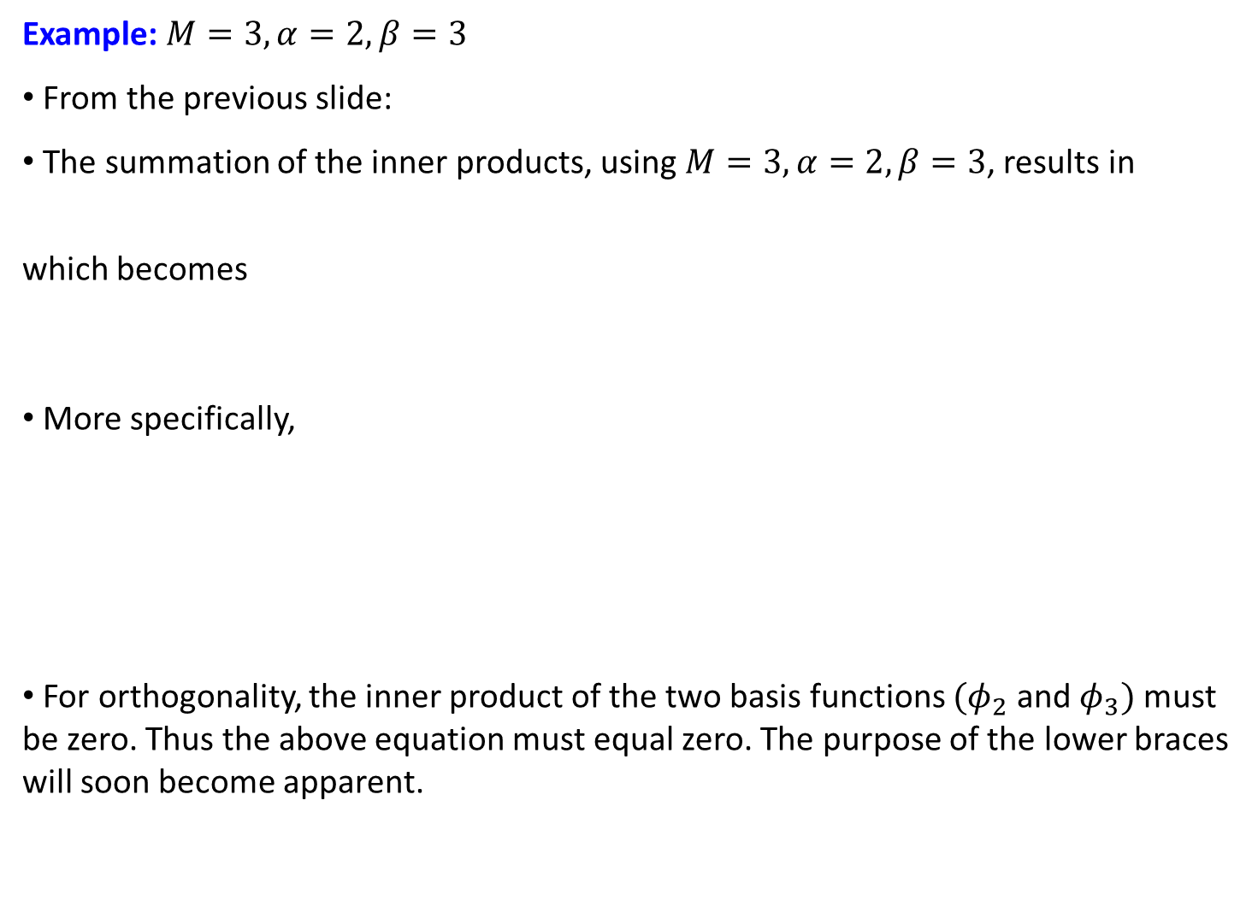
JUNKINS & WOOLLANDS
Picard-Chebyshev Lecture Series
#1 Orthogonal Approximation
EXAMPLE
Example: $M=3,α=2,β=3$
From the previous slide:
The summation of the inner products, using $M=3,α=2,β=3$, results in
which becomes
More specifically,
For orthogonality, the inner product of the two basis functions ${(φ}_{2}$ and $φ_{3})$ must be zero. Thus the above equation must equal zero. The purpose of the lower braces will soon become apparent.
15

Slide 16
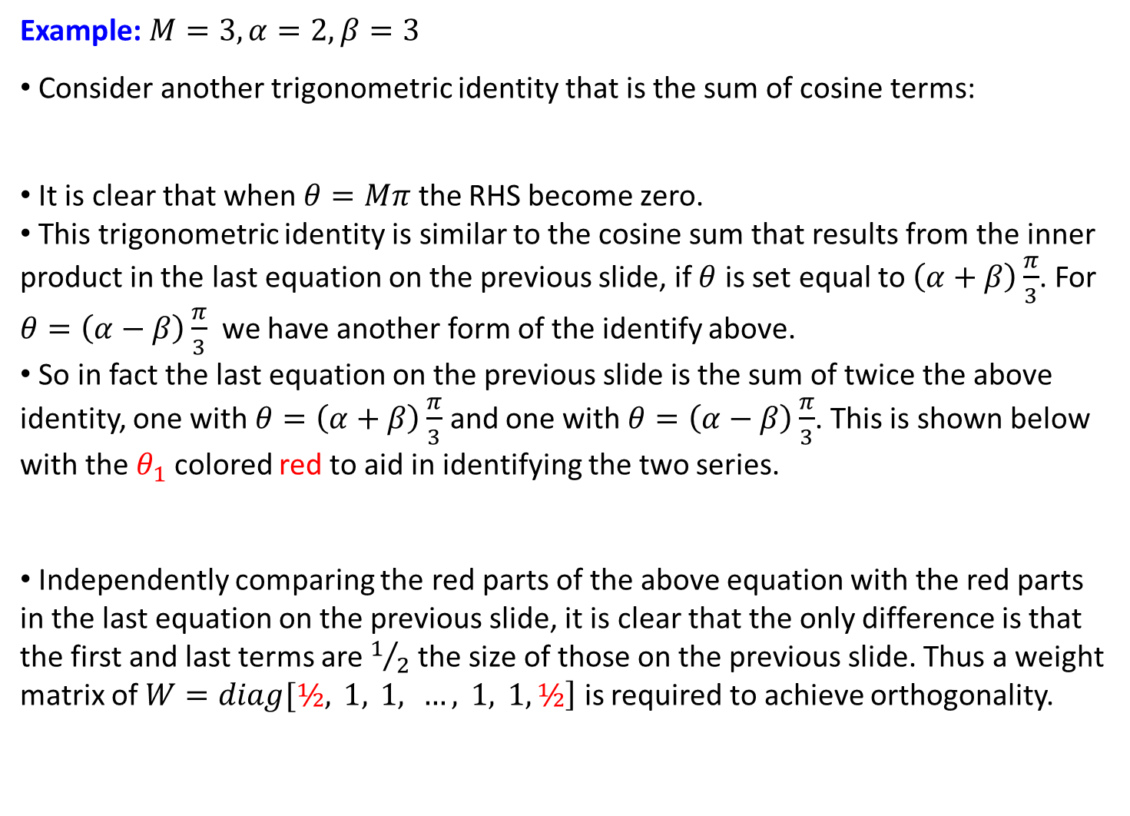
JUNKINS & WOOLLANDS
Picard-Chebyshev Lecture Series
#1 Orthogonal Approximation
EXAMPLE CONTINUED
Example: $M=3,α=2,β=3$
Consider another trigonometric identity that is the sum of cosine terms:
It is clear that when $θ=Mπ$ the RHS become zero.
This trigonometric identity is similar to the cosine sum that results from the inner product in the last equation on the previous slide, if $θ$ is set equal to $\left(α+β\right)\frac{π}{3}$. For $θ=\left(α−β\right)\frac{π}{3}$ we have another form of the identify above.
So in fact the last equation on the previous slide is the sum of twice the above identity, one with $θ=\left(α+β\right)\frac{π}{3}$ and one with $θ=\left(α−β\right)\frac{π}{3}$. This is shown below with the $θ_{1}$ colored red to aid in identifying the two series.
Independently comparing the red parts of the above equation with the red parts in the last equation on the previous slide, it is clear that the only difference is that the first and last terms are $1/2$ the size of those on the previous slide. Thus a weight matrix of $\left.W=diag[½, 1, 1, …, 1, 1,½\right]$ is required to achieve orthogonality.
16

Slide 17
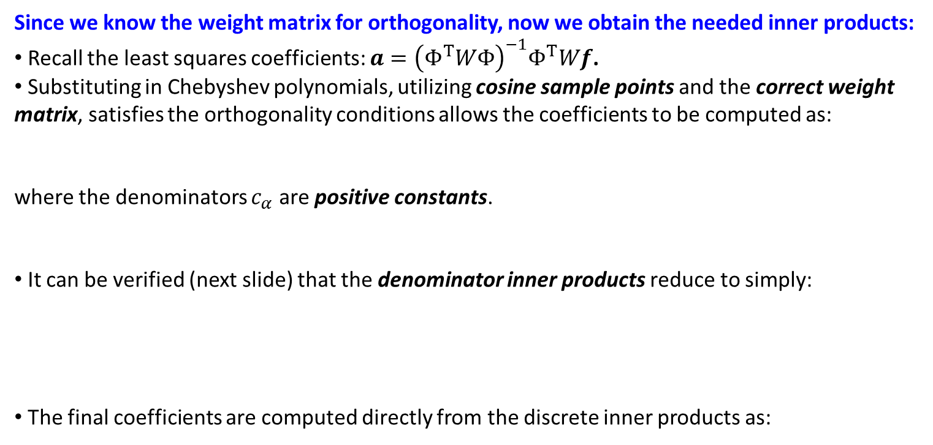
JUNKINS & WOOLLANDS
Picard-Chebyshev Lecture Series
#1 Orthogonal Approximation
CHEBYSHEV COEFFICIENTS
Since we know the weight matrix for orthogonality, now we obtain the needed inner products:
Recall the least squares coefficients: $a={\left(Φ^{T}WΦ\right)}^{−1}Φ^{T}Wf$.
Substituting in Chebyshev polynomials, utilizing cosine sample points and the correct weight matrix, satisfies the orthogonality conditions allows the coefficients to be computed as:
where the denominators $c_{α}$ are positive constants.
It can be verified (next slide) that the denominator inner products reduce to simply:
The final coefficients are computed directly from the discrete inner products as:
17

Slide 18
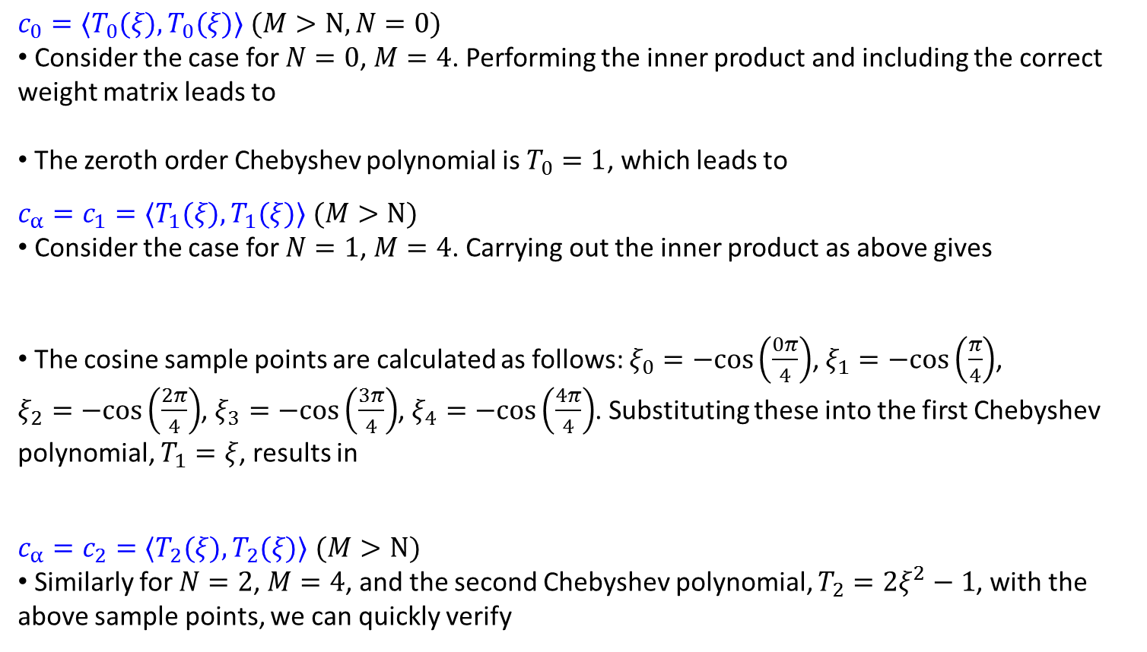
JUNKINS & WOOLLANDS
Picard-Chebyshev Lecture Series
#1 Orthogonal Approximation
VERIFICATION OF $c_{0}$, $c_{α}$, $c_{N}$
$c_{0}=〈T_{0}(ξ),T_{0}(ξ)〉$ $(M>N, N=0)$
Consider the case for $N=0$, $M=4$. Performing the inner product and including the correct weight matrix leads to
The zeroth order Chebyshev polynomial is $T_{0}=1$, which leads to
$c_{α}=c_{1}=〈T_{1}(ξ),T_{1}(ξ)〉$ $(M>N)$
Consider the case for $N=1$, $M=4$. Carrying out the inner product as above gives
The cosine sample points are calculated as follows: $ξ_{0}=−\text{cos}\left(\frac{0π}{4}\right)$, $ξ_{1}=−\text{cos}\left(\frac{π}{4}\right)$,
$ξ_{2}=−\text{cos}\left(\frac{2π}{4}\right)$, $ξ_{3}=−\text{cos}\left(\frac{3π}{4}\right)$, $ξ_{4}=−\text{cos}\left(\frac{4π}{4}\right)$. Substituting these into the first Chebyshev polynomial, $T_{1}=ξ$, results in
$c_{α}=c_{2}=〈T_{2}(ξ),T_{2}(ξ)〉$ $(M>N)$
Similarly for $N=2$, $M=4$, and the second Chebyshev polynomial, $T_{2}=2ξ^{2}−1$, with the above sample points, we can quickly verify
18

Slide 19
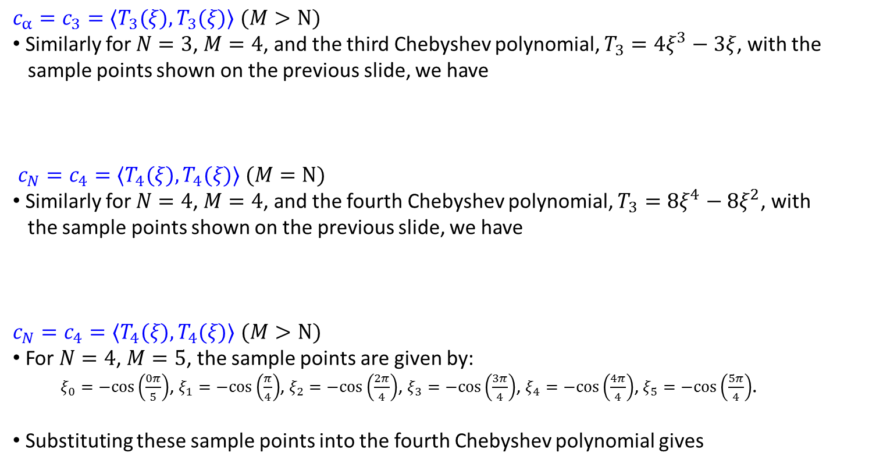
JUNKINS & WOOLLANDS
Picard-Chebyshev Lecture Series
#1 Orthogonal Approximation
VERIFICATION OF $c_{0}$, $c_{α}$, $c_{N}$ CONTINUED
$c_{α}=c_{3}=〈T_{3}(ξ),T_{3}(ξ)〉$ $(M>N)$
Similarly for $N=3$, $M=4$, and the third Chebyshev polynomial, $T_{3}=4ξ^{3}−3ξ$, with the sample points shown on the previous slide, we have
$c_{N}=c_{4}=〈T_{4}(ξ),T_{4}(ξ)〉$ $(M=N)$
Similarly for $N=4$, $M=4$, and the fourth Chebyshev polynomial, $T_{3}=8ξ^{4}−8ξ^{2}$, with the sample points shown on the previous slide, we have
$c_{N}=c_{4}=〈T_{4}(ξ),T_{4}(ξ)〉$ $(M>N)$
For $N=4$, $M=5$, the sample points are given by:
$ξ_{0}=−\text{cos}\left(\frac{0π}{5}\right)$, $ξ_{1}=−\text{cos}\left(\frac{π}{4}\right)$, $ξ_{2}=−\text{cos}\left(\frac{2π}{4}\right)$, $ξ_{3}=−\text{cos}\left(\frac{3π}{4}\right)$, $ξ_{4}=−\text{cos}\left(\frac{4π}{4}\right)$, $ξ_{5}=−\text{cos}\left(\frac{5π}{4}\right)$.
Substituting these sample points into the fourth Chebyshev polynomial gives
19

Slide 20
JUNKINS & WOOLLANDS
Picard-Chebyshev Lecture Series
#1 Orthogonal Approximation
VECTOR MATRIX NOTATION
Coefficients
The least squares solution may be expressed in vector matrix form:
where
The least squares operator (A) is simply given by
M=N M>N
In general, matrix A is an [N+1]x[M+1] matrix. The number of rows is determined by the degree of the polynomial and the number of columns is determined by the number of sample points.
20

Slide 21
JUNKINS & WOOLLANDS
Picard-Chebyshev Lecture Series
#1 Orthogonal Approximation
FUNCTION APPROXIMATION
Return to Function Approximation:
Using summation notation the function is approximated in terms of the matrices T, V, W and f as follows:
Least squares fit to discrete acceleration
samples to obtain coefficients
for acceleration
Function
approximation
Chebyshev basis
functions
We have now approximated the function. We can show via examples and arguments based on completeness, that almost any smooth function can be approximated, in an at worst a piecewise continuous fashion, with near machine precision …
21

Slide 22
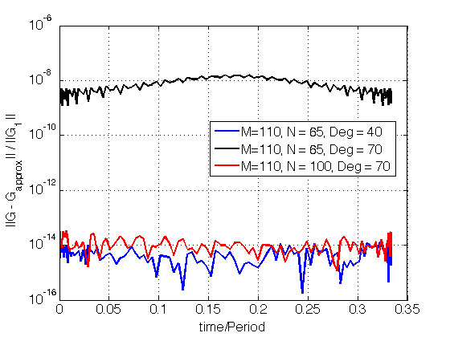
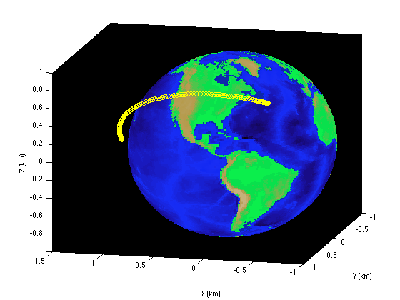
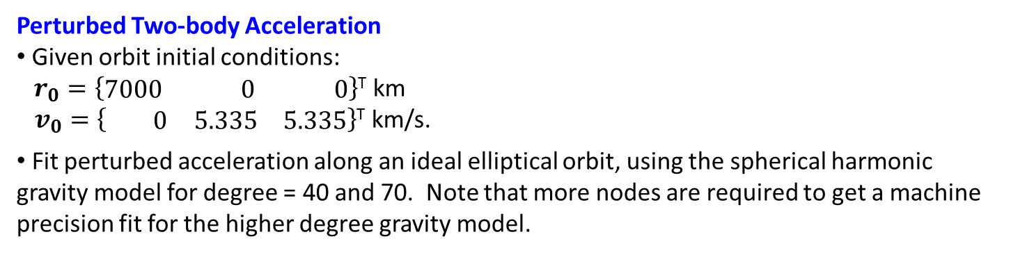
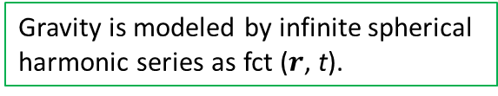
JUNKINS & WOOLLANDS
Picard-Chebyshev Lecture Series
#1 Orthogonal Approximation
APPROXIMATION EXAMPLE
Perturbed Two-body Acceleration
Given orbit initial conditions: $r_{0}=\left\{\begin{matrix}7000 & 0 & 0\end{matrix}\right\}$^{T} km
$v_{0}=\left\{\begin{matrix} 0 & 5.335 & 5.335\end{matrix}\right\}$^{T} km/s.
Fit perturbed acceleration along an ideal elliptical orbit, using the spherical harmonic gravity model for degree = 40 and 70. Note that more nodes are required to get a machine precision fit for the higher degree gravity model.
Gravity is modeled by infinite spherical
harmonic series as fct ($r$, t).
Acceleration fit over this 1/3 of an orbit
Engineering Accuracy
Chasing Machine Precision
22

